Slide 1

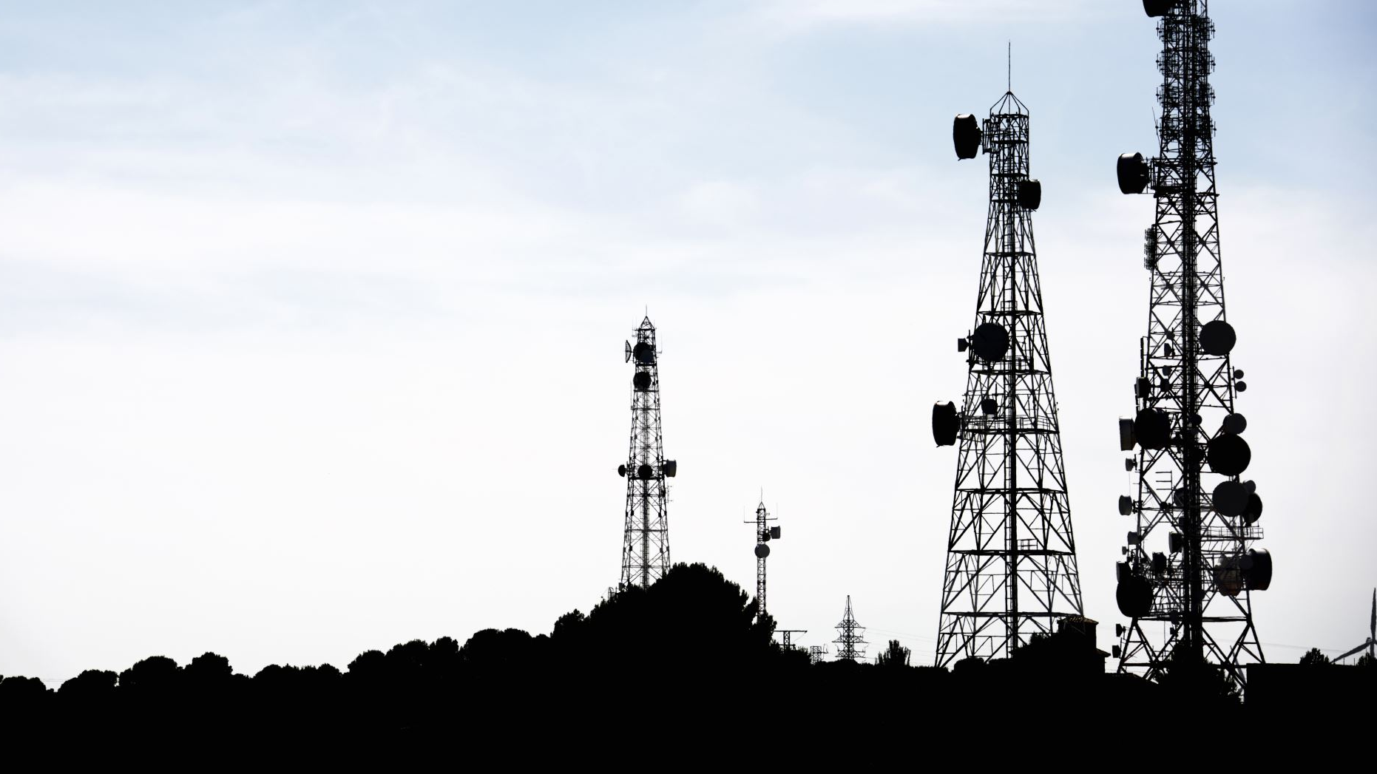
IoT-Based Weather Station System

Slide 2
Presented By-
Team Iotrix
Avik Halder [2001009]
Hrithik Das [2001016]
Md Tasnim Mahmud Fahim [2001017]
Maliha Rahman Mitu [2001020]
Jakaria Saikat Dhrobo [2001022]

Slide 3
OUTLINES
Introduction
Objectives
Apparatus
Key Features
Methodology
Flow Chart
Limitations
Future Work
Conclusion
Circuit Diagram

Slide 4
INTRODUCTION
The IoT-Based Weather Station System represents a groundbreaking approach to weather monitoring by leveraging the power of Internet of Things (IoT) technology.
In today's fast-paced world, accurate weather data is essential for a myriad of applications, from agriculture and transportation to disaster management and smart cities.

Slide 5
OBJECTIVES
Develop a weather station system using IoT technology.
Collect and process data from multiple sensors in real time.
Display weather parameters on an LCD screen locally.
Enable remote access to weather data through the internet.
Create a cost-effective and easily replicable system.

Slide 6
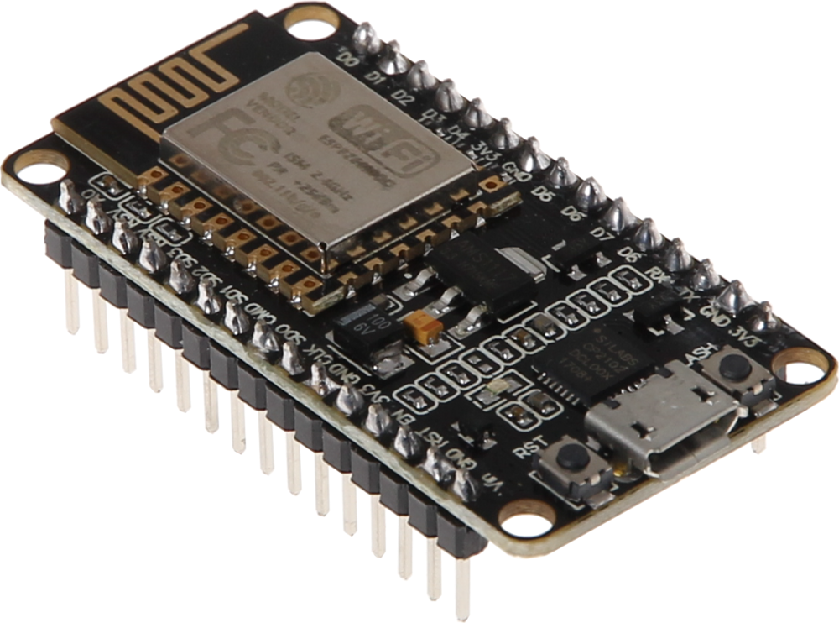
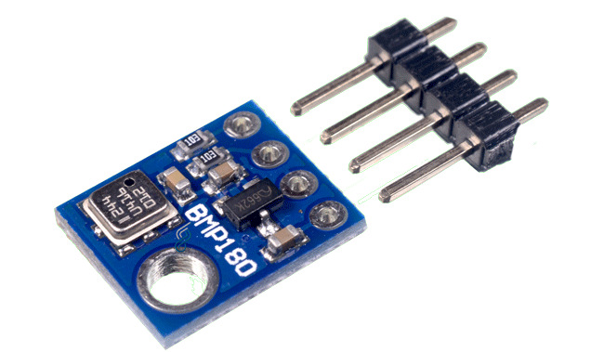
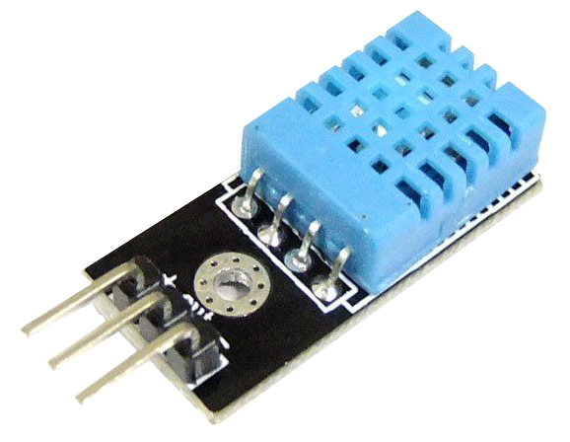
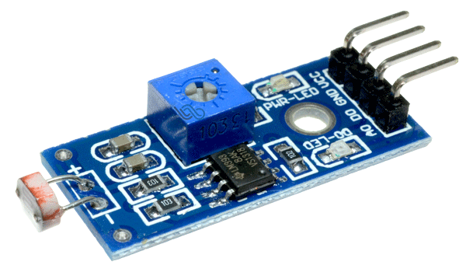
APPARATUS
Nodemcu (ESP8266)
BMP 180 sensor
LDR sensor
DHT11 sensor

Slide 7
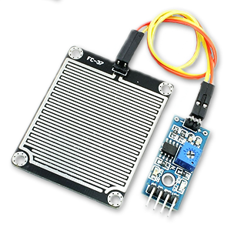
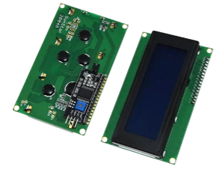
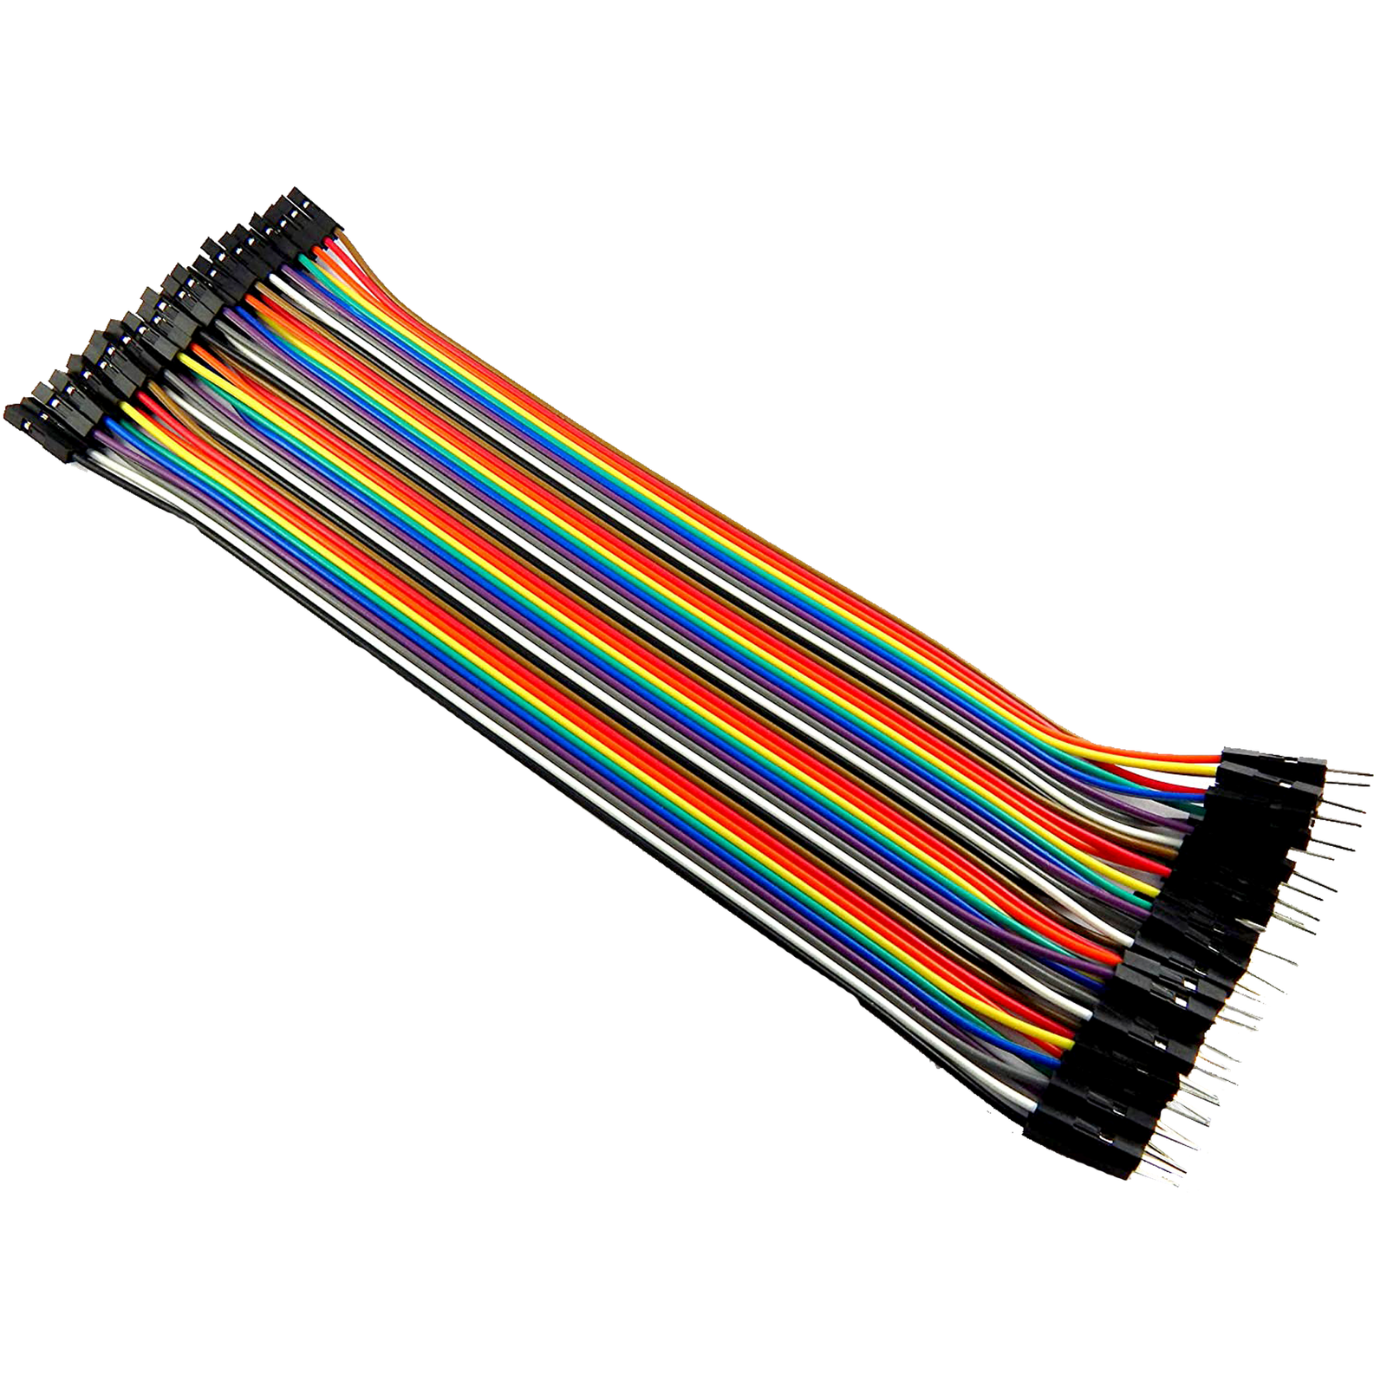
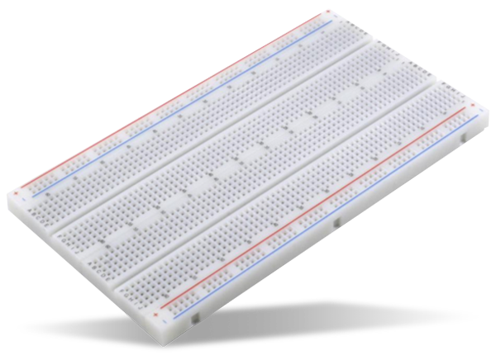
APPARATUS
LCD display with I2C Module
Rain Sensor
Jumper Wires
Breadboard

Slide 8
Key Features
Real-time Weather Data Monitoring
User-friendly Interface
Low Power Consumption
Remote Monitoring
Cost-effective Solution
Data Accuracy and Analysis

Slide 9
Methodology
Connect the sensors to the Nodemcu board using jumper wires and breadboard.
Write code to interface with each sensor and extract data.
Utilize the Nodemcu's Wi-Fi capabilities to establish an internet connection.
Implement code to transmit data to an online platform or server.
Develop a user interface to display data on the LCD screen using the I2C module.
Create a web-based dashboard to remotely access weather data.

Slide 10
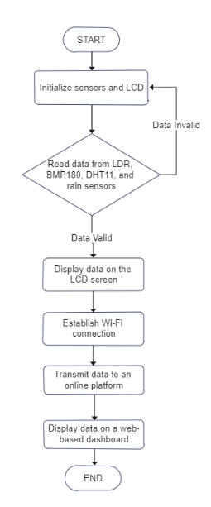
Flow Chart

Slide 11
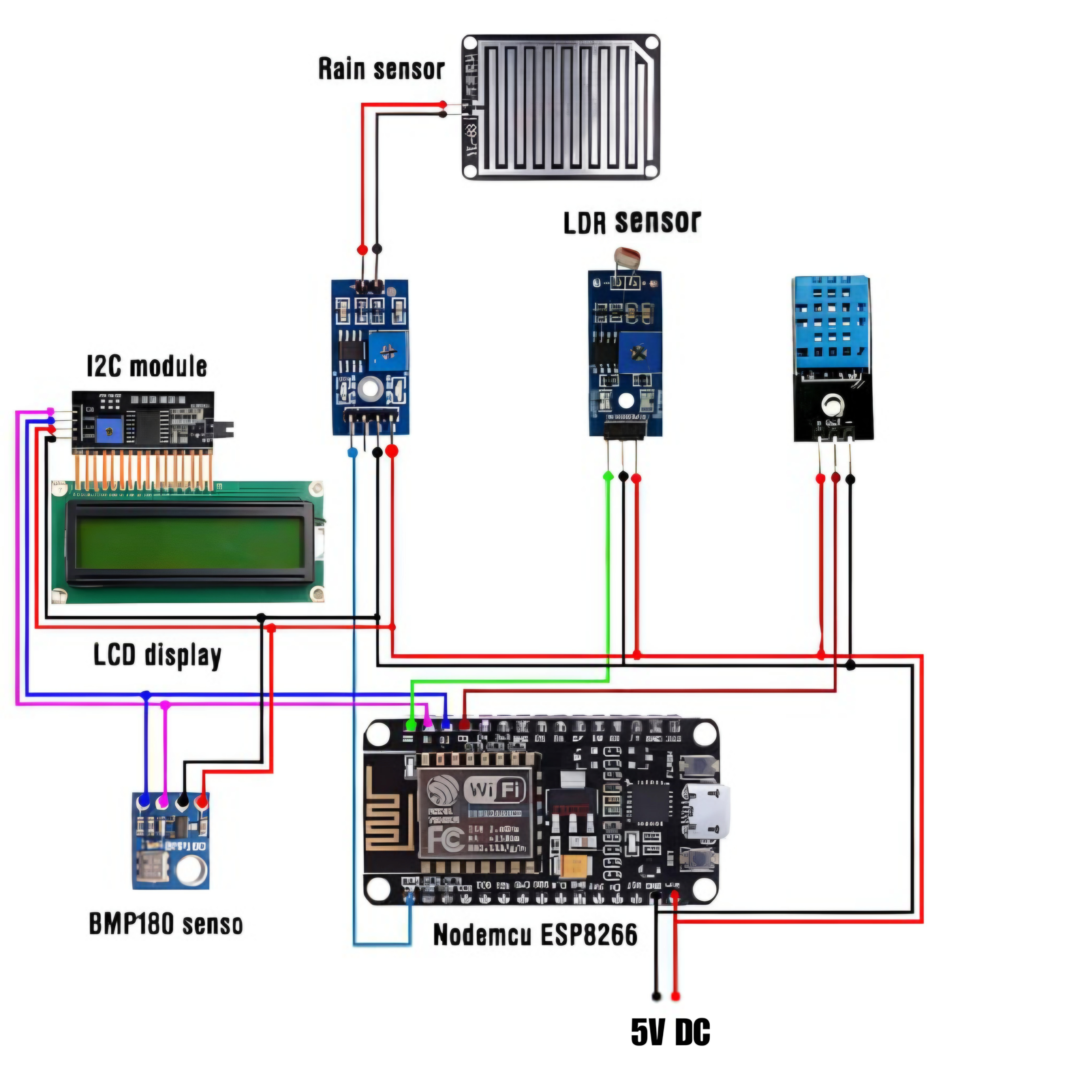




CIRCUIT DIAGRAM
DHT11 Sensor

Slide 12
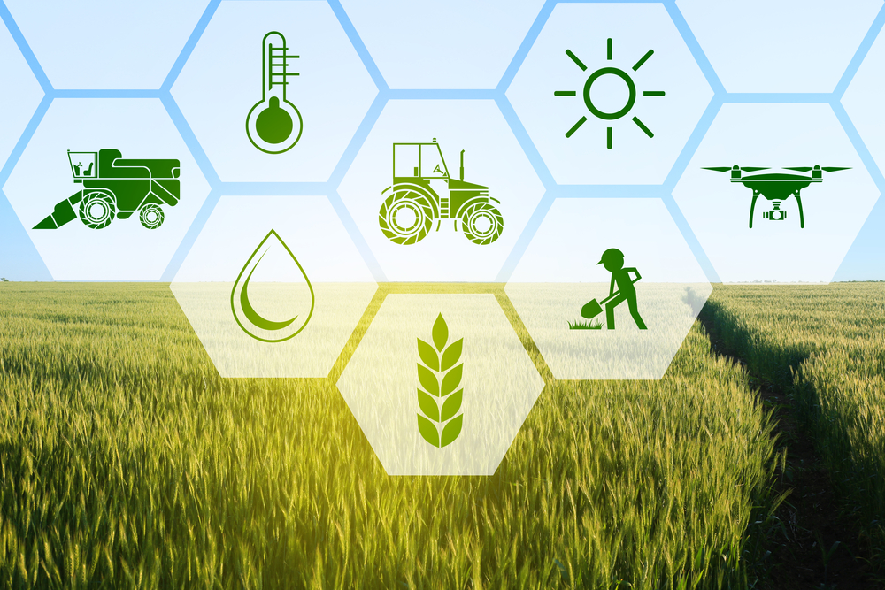

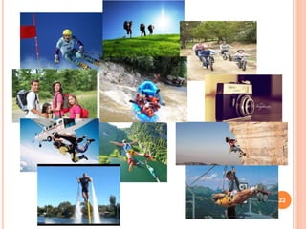
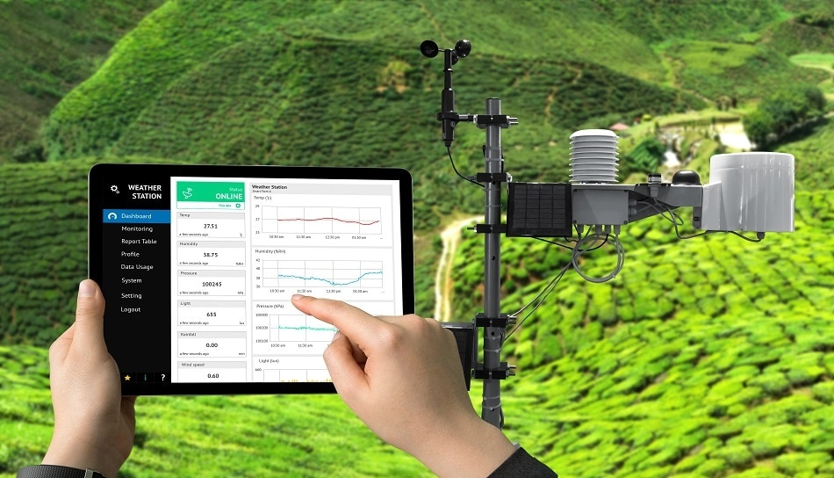
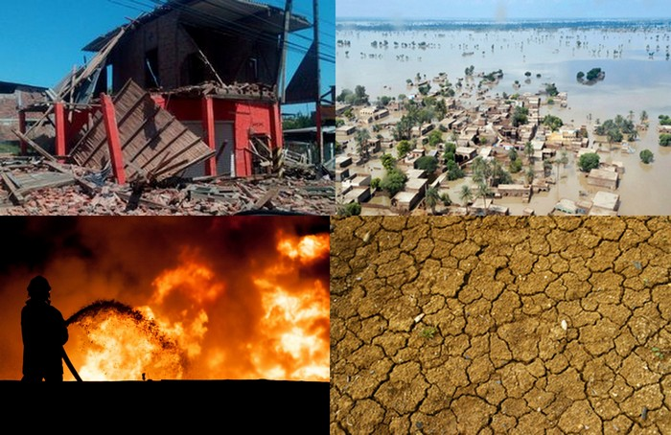
Applications
Agriculture
Transportation and Logistics
Tourism and Recreation
Environmental Monitoring
Emergency Management

Slide 13
Limitations
Limited Range: System effectiveness constrained by communication range, limiting coverage.
Internet Dependency: Vulnerable to disruptions without a stable internet connection.
Sensor Accuracy: Calibration challenges may impact data precision.
Power Dependency: Relies on consistent power sources, posing challenges in remote areas.

Slide 14
Future Work
Mobile App Integration: Plan to develop a user-friendly mobile application for convenient weather monitoring on smartphones.
Sensor Network Expansion: Expand the network by adding more sensors for comprehensive data collection and analysis.
Predictive Analytics: Implement predictive analytics to forecast weather patterns and trends based on collected data.

Slide 15
Conclusion
IoT-Based Weather Station System demonstrates practical IoT application in real-time weather data collection
Offers insights into sensor integration, data communication, and remote access
Utilizes affordable components and open-source platforms for cost-effective solution
Implications in education, practical use, and potential research in IoT and weather monitoring

Slide 16

Thank
You
If you have any queries, feel free to ask us

